Slide 1

Website Optimization

Slide 2
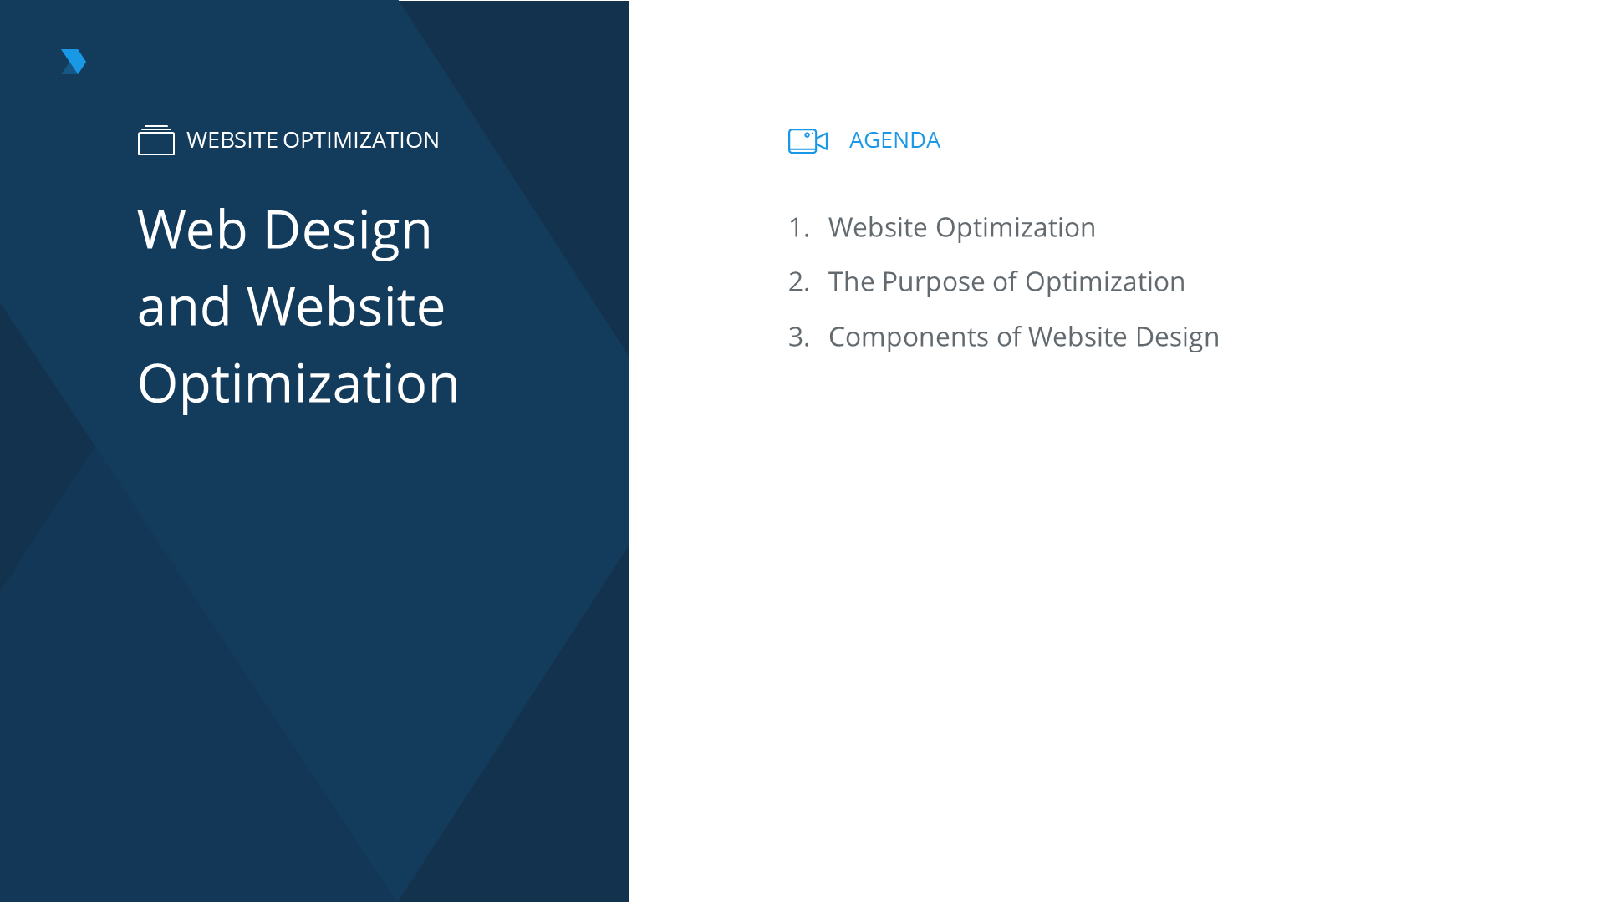

Slide 3
Website Optimization
What is it?
Website optimization is the art of creating and continuously improving websites to optimize the visitor experience, resulting in high visitor satisfaction, better user experience, and high repeat visit and conversion rates.
Notes:
[REF] 1.1.1.1

Slide 4
Website Optimization
What does it involve?
UX
UX
Design
Display
Notes:
[REF] 1.1.1.2

Slide 5
Website Optimization
What is SEO?
Search engine optimization (SEO) involves making sure that the website’s information and quality are optimized correctly, according to best SEO practices.
Notes:
[REF] 1.1.1.3

Slide 6
Website Optimization
The difference between website optimization and SEO
Website Optimization
Deals more with the user experience and making the website easier to use
SEO
Makes it easier for search engines to find and index website content
Vs.
Notes:
[REF] 1.1.1.4

Slide 7
Purpose of Website Optimization
Increase user time on site
Provide a better user experience
Lead to more return visits
Increase e-commerce sales
25% abandonment rate benchmark for poor design
Notes:
[REF.] 1.1.2.1

Slide 8
Website Optimization Affects Buyer Journey
Awareness
Awareness
The buyer is aware of a problem and they’re trying to find initial solutions
Interest
Consideration
Conversion
Retention
Notes:
[REF.] 1.1.2.2

Slide 9
Barriers to Conversion
Confusing Navigation
Slow Checkout Process
If a user doesn’t know where to find the information or product that they are looking for, they are likely to get frustrated and leave the website entirely, possibly to never return
Unclear Benefits to Converting
Slow Website
Notes:
[REF.] 1.1.2.3

Slide 10
6.1.1.5
Understand that data breaches can not only damage your business but your brand if publicly discussed
Website Optimization Affects Digital Marketing Areas
SEO
SEO
Graphic Design
Poor design and navigation can make it hard for search engines to crawl a site in order to index it. This can affect whether or not it is shown in search results.
A/B Testing
Email Marketing
Social Media
Mobile Optimization
Website Page Speed
Notes:
[REF.] 1.1.2.4

Slide 11
The Role of a Marketer in Website Design
Writing and editing website copy, including calls-to-action
1
5
2
6
4
3
Notes:
[REF.] 1.1.2.5

Slide 12
6.1.1.5
Understand that data breaches can not only damage your business but your brand if publicly discussed
6.1.1.5
Understand that data breaches can not only damage your business but your brand if publicly discussed
Key Components of Effective Website Design
Architecture
Steps involved in building your website:
Choose a hosting provider, CMS, and domain name
Install CMS and required plugins or features
Build or install design or theme
Add graphic elements, text, and SEO
Test
Launch
Monitor for bugs as needed
1
Architecture
Design
2
Content
Optimization
3
4
5
6
7
Notes:
[REF.] 1.1.3.1

Slide 13
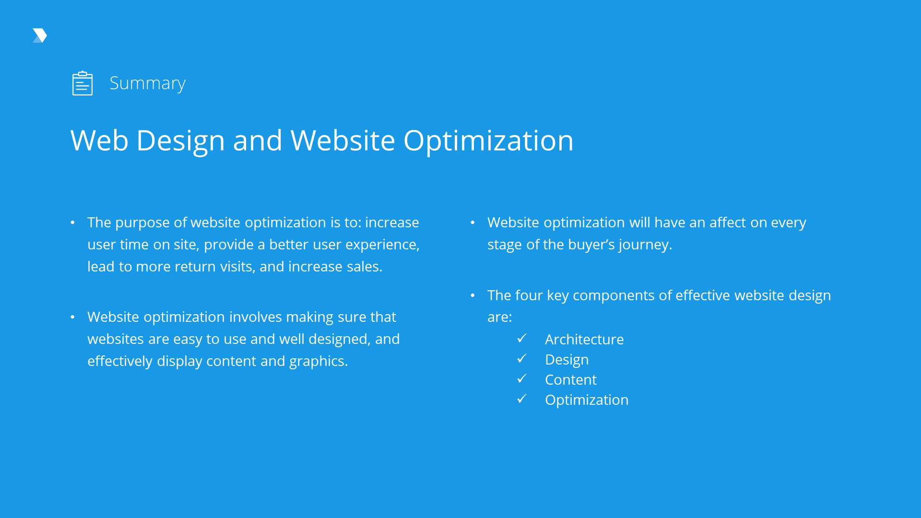

Slide 14
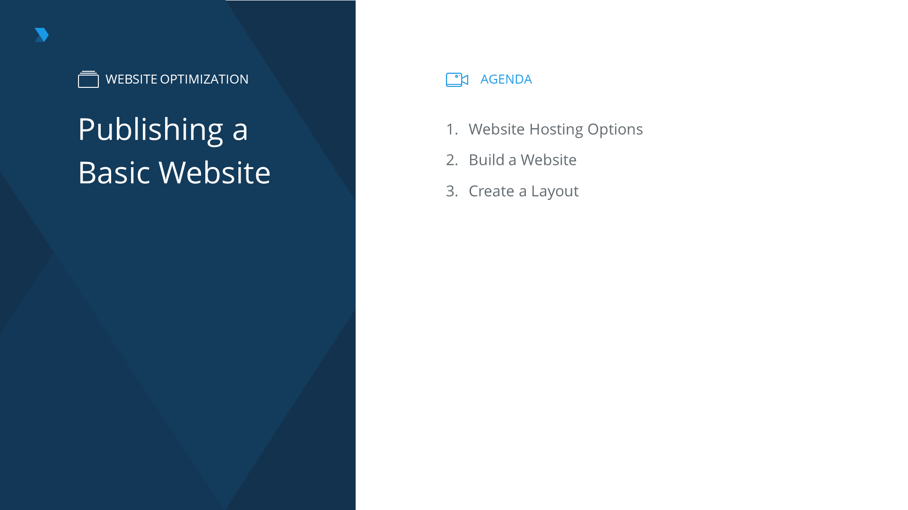

Slide 15
Website Hosting Options
What are the common website hosting types?
#1
Shared hosting
#2
Dedicated server
#3
Cloud hosting
#4
CMS-specific hosting
Notes:
[REF.] 1.2.1.1

Slide 16
Website Hosting Options
Benefits and limitations of hosting options
Hosting Option | Security | Affordability | Support | Downtime | Specific Requirements
Shared | 4 | 1 | 1 | 4 | The hosting provider may require a specific CMS, website size, monthly traffic etc. for a specific hosting plan
Dedicated | 1 | 4 | 1 | 1
Cloud | 3 | 3 | 3 | 3
CMS Specific Hosting | 2 | 2 | 2 | 2
Notes:
[REF.] 1.2.1.2

Slide 17
6.1.1.5
Understand that data breaches can not only damage your business but your brand if publicly discussed
WordPress.com and
WordPress.org
-
Wordpress.com
WordPress websites are free and run on WordPress servers, and their domains are usually something like, websitename.wordpress.com. Users can pay to have their own domain (e.g. website.com), but free hosting will still require ads on their site.
+
Wordpress.org
Notes:
[REF.] 1.2.2.1

Slide 18
Build a Website Using WordPress.org
Test and tweak as you go
Buy a domain and hosting plan
Set up tracking
CMS
Install WordPress
Setting up a website
Get your WordPress login
Write content and modify settings
Format plugins and themes
Log in at
yourwebsite.com/wp-admin
Add plugins
Install theme
Notes:
[REF.] 1.2.2.2

Slide 19
6.1.1.5
Understand that data breaches can not only damage your business but your brand if publicly discussed
WordPress Theme
A WordPress theme is a set of code and design files that create the overall look and feel of your website
REVEAL MORE
Notes:
[REF.] 1.2.2.3

Slide 20
6.1.1.5
Understand that data breaches can not only damage your business but your brand if publicly discussed
WordPress Theme
There are different types of themes based on their purpose. These include:
A WordPress theme is a set of code and design files that create the overall look and feel of your website
Blog or Newspaper Business and services E-commerce Beauty Sports Fashion
REVEAL MORE
Notes:
[REF.] 1.2.2.3

Slide 21
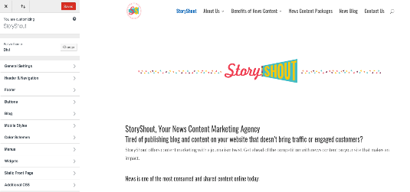

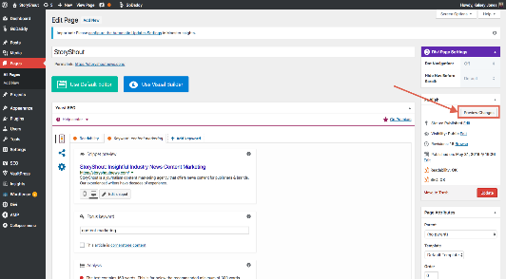
6.1.1.5
Understand that data breaches can not only damage your business but your brand if publicly discussed
Testing Themes across Devices
c
A
B
Notes:
[REF.] 1.2.2.4

Slide 22
6.1.1.5
Understand that data breaches can not only damage your business but your brand if publicly discussed
Reputable Sources of WordPress Themes
Find reputable sources of WordPress themes by looking for highly rated theme sites that have a good reputation. Examples include ThemeForest, ElegantThemes, and TemplateMonster.
Notes:
[REF.] 1.2.2.5

Slide 23
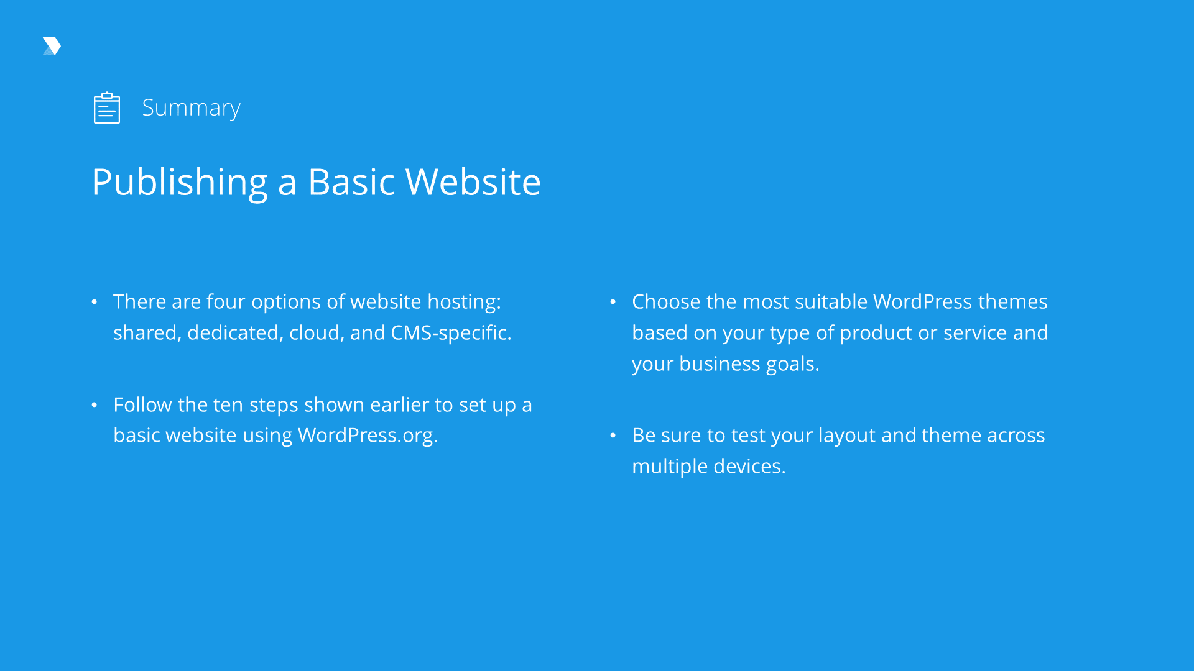

Slide 24
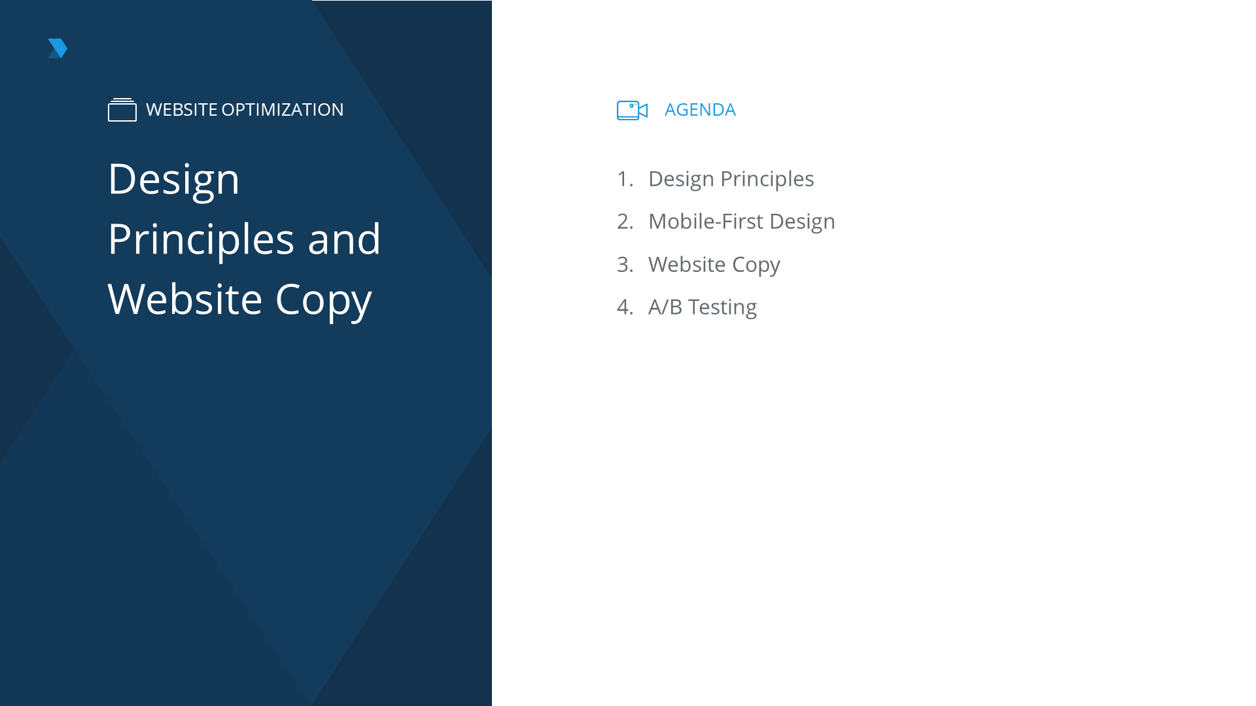

Slide 25
Design Principles
The importance of web design
First Impressions
A business’s first impression online
Information
Information is organized in a way that makes sense
Navigation
Allowing the user to navigate easily
Content
Making the content easier to understand
Notes:
[REF.] 1.3.1.1

Slide 26
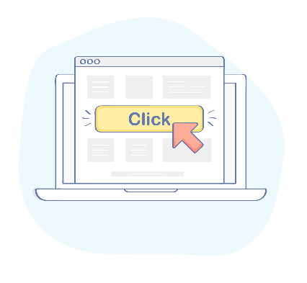
Design Principles
The key aspects of web design
Simple design
Easy to navigate
Consistency of information
Usability
Consistency of design
Concise and honest information
Notes:
[REF.] 1.3.1.2

Slide 27
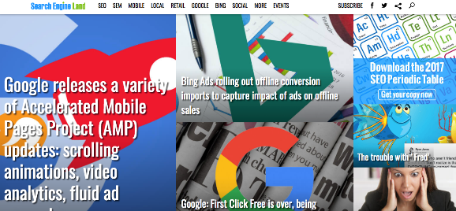
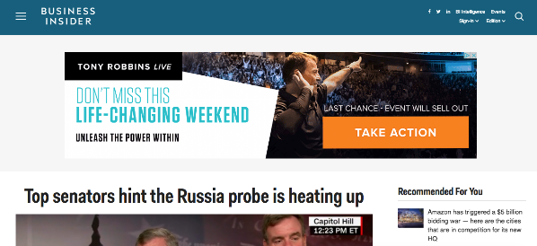
Design Principles
#1 Simple design
Notes:
[REF.] 1.3.1.3

Slide 28
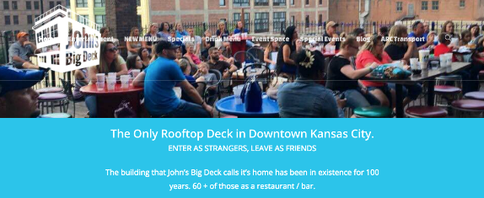

Design Principles
#2 Navigation
Notes:
[REF.] 1.3.1.4

Slide 29
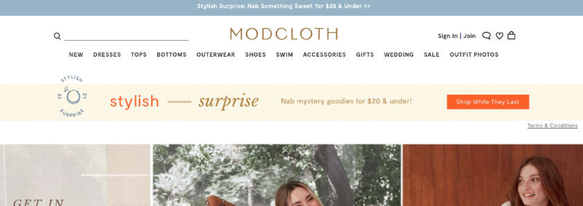
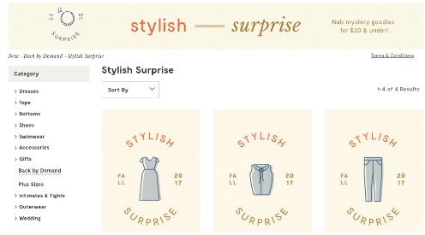
Design Principles
#3 Consistent information
Notes:
[REF.] 1.3.1.5

Slide 30
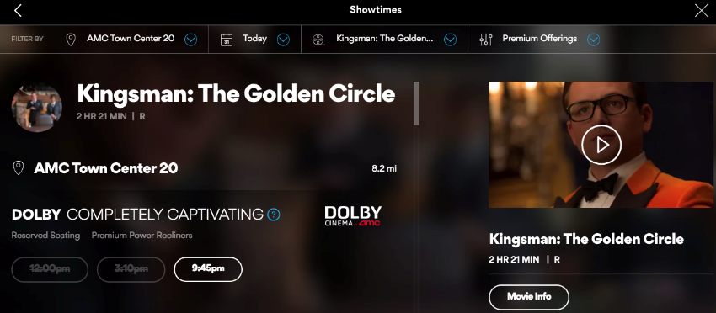
Design Principles
#4 Usability
Notes:
[REF.] 1.3.1.6

Slide 31


Design Principles
#5 Consistent design
All parts of the website should look the same
Notes:
[REF.] 1.3.1.7

Slide 32

Design Principles
#6 Concise and honest information
Make sure websites are concise, truthful, and don’t overdo content when it’s not needed
Notes:
[REF.] 1.3.1.8

Slide 33
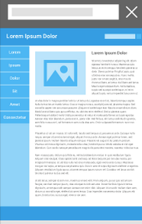
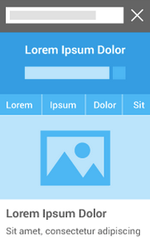
6.1.1.5
Understand that data breaches can not only damage your business but your brand if publicly discussed
Impact of “Mobilegeddon”
“Mobilegeddon” was an announcement from Google stating that websites that are not mobile-friendly may not be shown to users in mobile search results. Because of this and Google’s mobile-first index, mobile is the priority for SEO
Notes:
[REF.] 1.3.2.1

Slide 34
6.1.1.5
Understand that data breaches can not only damage your business but your brand if publicly discussed
Mobile Friendly Versus Responsive
-
Mobile Friendly
A different version of a website that is shown to mobile users
+
Responsive
Notes:
[REF.] 1.3.2.2

Slide 35
SEO and Website Optimization Work Together in Mobile
Mobile-first
Experience
CTAs
Content
Notes:
[REF.] 1.3.2.3

Slide 36
SEO and Website Optimization Work Together in Mobile
Mobile-first Experience
CTAs
Content
Create a mobile-first experience
Use CTAs focused on mobile users
Create content that is based on what a mobile user would be looking for
Notes:
[REF.] 1.3.2.3

Slide 37
Website Copy
The basics of effective copy
Clear
“We offer air conditioning units to restaurants and hotels.”
Enticing
“We offer award-winning, certified air conditioning units to restaurants and hotels. No other competitors offer our same 10-year warranty.”
Unique
“No other competitors offer our same 10-year warranty.”
Notes:
[REF.] 1.3.3.1

Slide 38
Website Copy
Website content
1. Easy to read
2. Easy to find
3. Ease to understand
4. Includes a CTA on each page
5. Pages work together
Notes:
[REF.] 1.3.3.2

Slide 39
Website Copy
Make sure to include CTAs
Use a clear, concise command
Highlight how the offer benefits the user
Show social proof
Show sense of urgency
50% OFF
BUY NOW
LOW RATE
Notes:
[REF.] 1.3.3.3

Slide 40
Website Copy
Creating a cohesive experience
Home page offers should appear on interior product pages
Key messaging should remain the same on all pages
Voice and tone need to be the same (e.g. stay in 1st or 3rd person)
Notes:
[REF.] 1.3.3.4

Slide 41
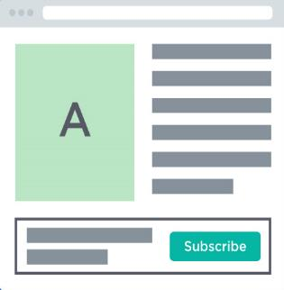
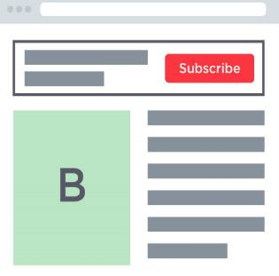
6.1.1.5
Understand that data breaches can not only damage your business but your brand if publicly discussed
A/B Testing
A/B testing means comparing two different elements of a website to determine which receives more clicks, conversions, and engagement
REVEAL MORE
Notes:
[REF.] 1.3.4.1

Slide 42
6.1.1.5
Understand that data breaches can not only damage your business but your brand if publicly discussed
A/B Testing
Areas where A/B Testing is useful
A/B testing means comparing two different elements of a website to determine which receives more clicks, conversions, and engagement
Call-to-actions (CTAs)
Headlines
Graphic elements
Wording and content
Type of promotion or offer
Pop-ups
1
2
3
4
5
6
REVEAL MORE
Notes:
[REF.] 1.3.4.1

Slide 43
6.1.1.5
Understand that data breaches can not only damage your business but your brand if publicly discussed
Best Practice for A/B Testing
Step1
Step 2
Step 3
Step 4
Step 5
Pick one variable to test
Notes:
[REF.] 1.3.4.2

Slide 44
A/B Testing Tools and Plugins
NelioABTesting.com
SimplePageTester.com
Optimizely
Five Second Test
VWMO
Good for testing different elements on a WordPress site
Notes:
[REF.] 1.3.4.3

Slide 45
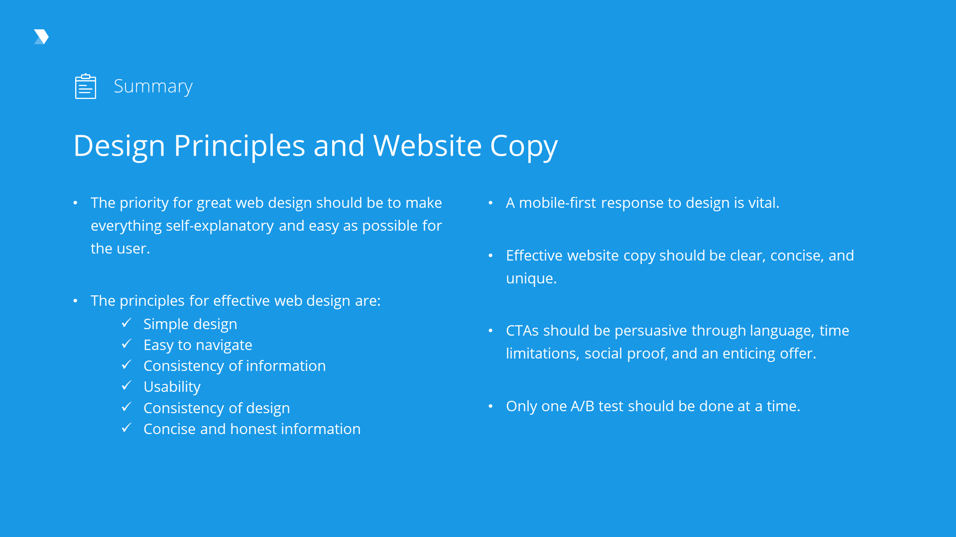

Slide 46
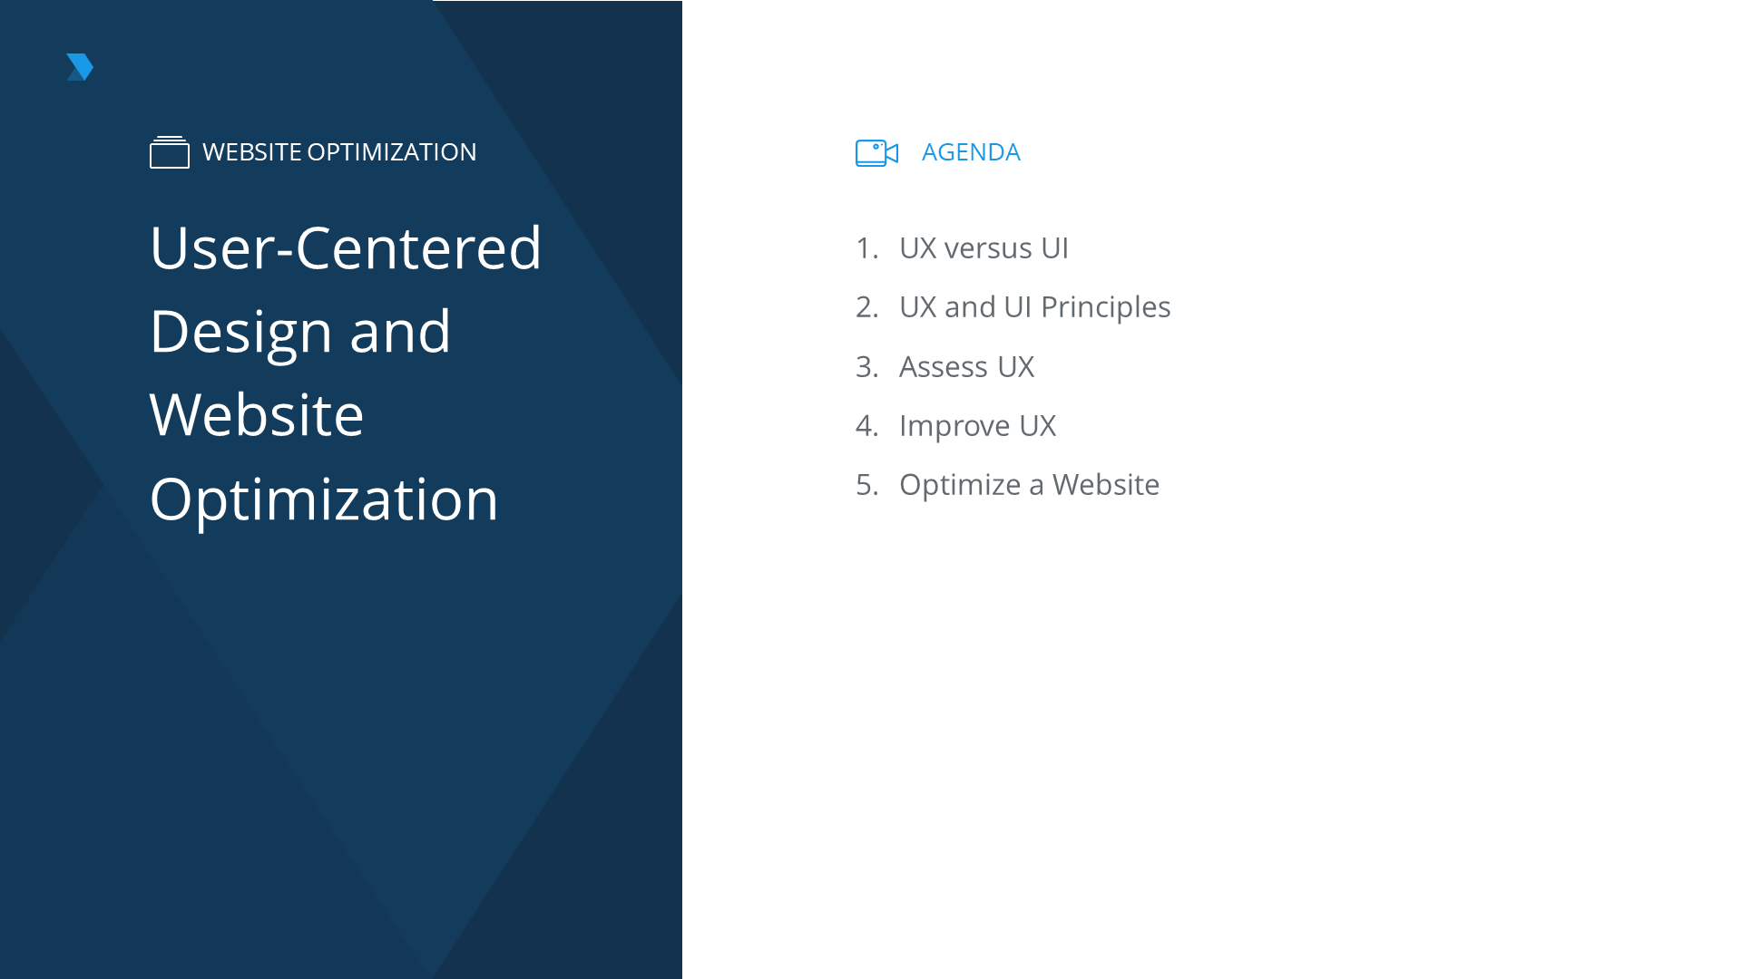

Slide 47

UX versus UI
What is user experience?
User experience is defined as a person’s perceptions and responses resulting from the use and or anticipated use of a product, system, or service.
Notes:
[REF.] 1.4.1.1

Slide 48
UX versus UI
What is a user interface?
UI is the platform on which the user and website interact with one another. This includes elements such as clickable links, forms, and other actions a user can complete on a website.
Notes:
[REF.] 1.4.1.2

Slide 49
UX versus UI
The difference between UX and UI
UX - The experience | UI - The medium
Interaction design | Visual design
Based on data, emotion, & user research | Based on design trends & brand guidelines
Wireframes, site maps, & personas | Colors, typography, and layout
Notes:
[REF.] 1.4.1.3

Slide 50
6.1.1.5
Understand that data breaches can not only damage your business but your brand if publicly discussed
Benefits of UX and UI
UX and UI are important to website optimization because they help to provide a better website that gives users the information they need, when they need it
More Traffic
The easier a site is to use and navigate, the more likely it is to be shown to users in search engine results and the more its content will be shared on social media by customers and users. This all leads to more website traffic.
More Traffic
Increased Retention
Increased Time on Site
Deeper Emotional Connection
More Conversions
Better Return Rate
Notes:
[REF.] 1.4.2.1

Slide 51
Principles of Good UX and UI
Accessibility
Notes:
[REF.] 1.4.2.2

Slide 52
Key UX and UI Attributes to A/B Test
User Intent
User Intent is what is the user looking to accomplish on a page
User Intent
Influence of Web Design on UX
Points of Friction
Navigation
Notes:
[REF.] 1.4.3.1

Slide 53

Poor Website Design
Notes:
[REF.] 1.4.3.2

Slide 54

Poor Website Design
Notes:
[REF.] 1.4.3.3

Slide 55
Good Website Navigation
Easier for Search Engines to crawl
Gets more clicks and traffic
Increase time on sites
Good website navigation brings the following benefits:
Gets more clicks and traffic to interior sub-pages. This can help the user get around the site more easily and find pages they may have not been able to find on their own before.
Notes:
[REF.] 1.4.4.1

Slide 56

Improving User Experience through Navigation
Notes:
[REF.] 1.4.4.2

Slide 57
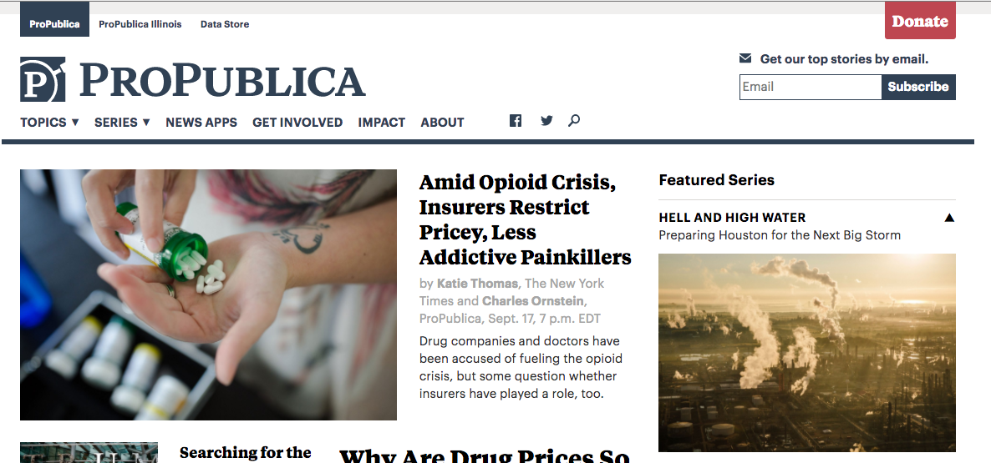
Improving User Experience through Navigation
Notes:
[REF.] 1.4.4.3

Slide 58
Responsive Website
Higher Preference in Search Results
Better Designs Across Devices
Better User Experience
A responsive website across desktop, mobile, and tablet devices brings the following benefits:
Users are able to see all of the information on the page and they don’t have to pinch the screen, squint, or try to see something that is cut off. It also makes the text easier to read and navigation easier to use.
Notes:
[REF.] 1.4.4.4

Slide 59
User Expectations and Intent Differ Across Different Devices
A/B test placement of contact information, reviews, services, and CTAs across different devices to see what gets more clicks
What a user is looking for on mobile may be different than desktop
Points of Friction
Influence of Web Design on UX
Notes:
[REF.] 1.4.4.5

Slide 60
Best Practice for CTAs
Use action words
Notes:
[REF.] 1.4.4.6

Slide 61
6.1.1.5
Understand that data breaches can not only damage your business but your brand if publicly discussed
Selecting Call-to-actions
1
Select the best CTAs for your audience through testing different wording, feature boxes, offers, and more. (These may also vary by device).
2
Align the user experience to your specific audience. Some audiences want a simpler experience, while others expect something more complex
Notes:
[REF.] 1.4.4.7

Slide 62
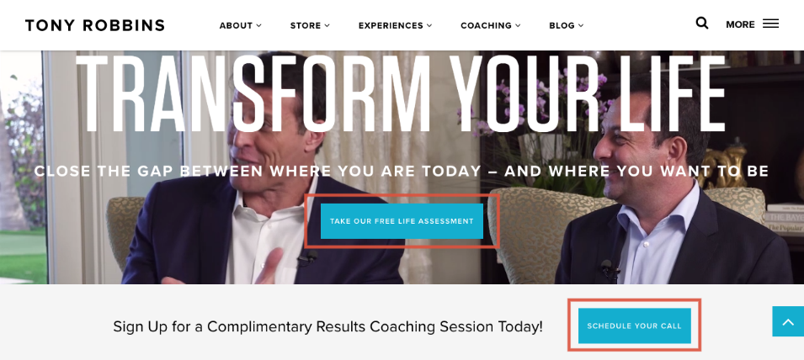
Optimizing CTAs for Your Specific Audience
Notes:
[REF.] 1.4.4.8

Slide 63

Optimizing CTAs for Your Specific Audience
Notes:
[REF.] 1.4.4.9

Slide 64
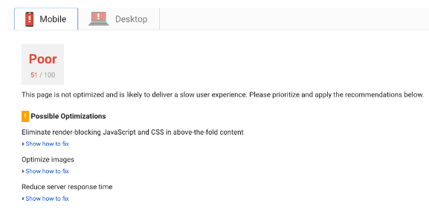
Optimize a Website
Page speed
Page speed is a ranking factor
Mobile users are much more likely to leave if it takes longer than 3 seconds
Page speed is an indicator of other issues with the site
Notes:
[REF.] 1.4.5.1

Slide 65
Optimize a Website
How hosting and website design affects page speed and optimization
Hosting Providers
Hosted Files/Code
Website Elements
Images
Notes:
[REF.] 1.4.5.2

Slide 66

Optimize a Website
How hosting and website design affects website optimization
Elements that don’t load correctly lead to other “broken” areas of the site
Errors can affect what information is shown to user
Notes:
[REF.] 1.4.5.3

Slide 67
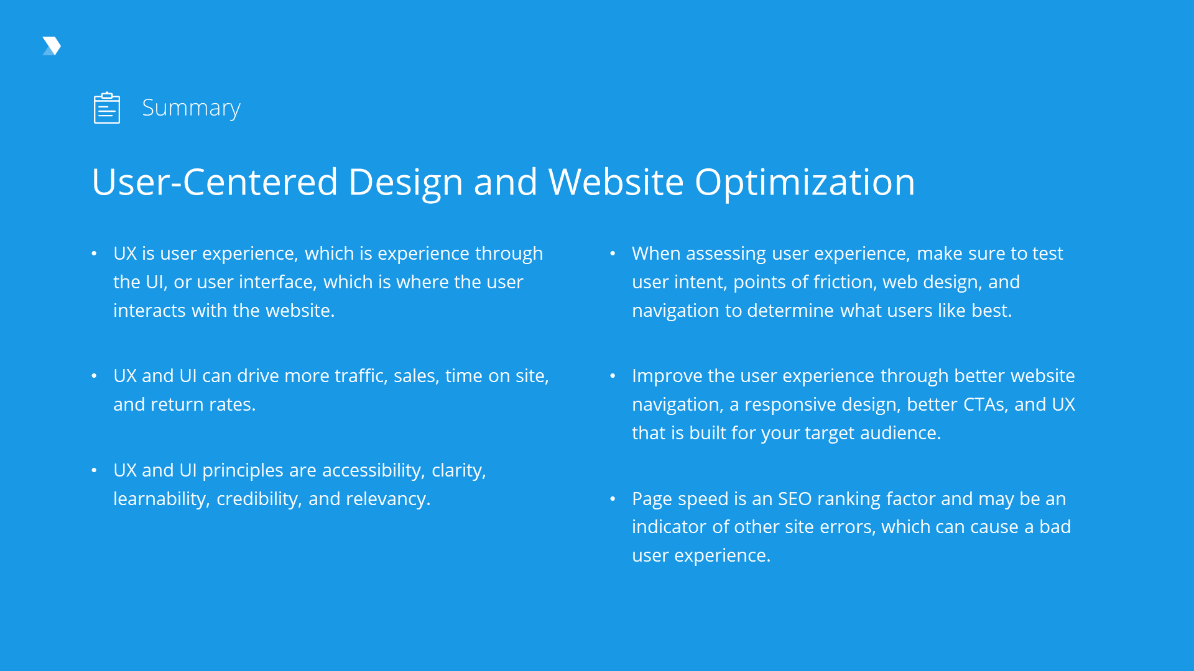

Slide 68
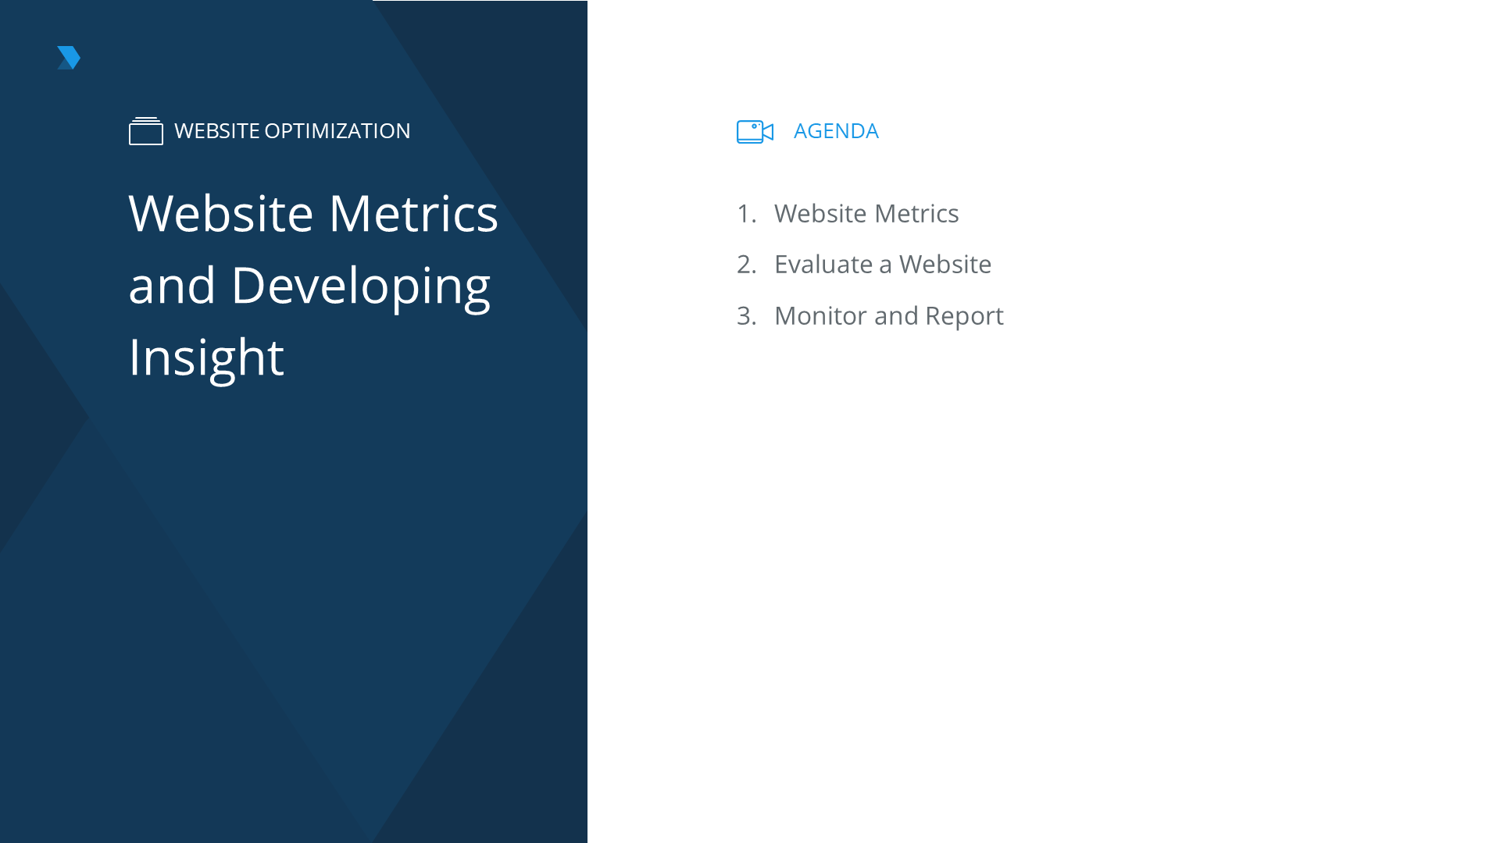

Slide 69
Website Metrics
SMART goals
Specific
Measureable
Achieveable
Relevant
Timed
S
M
A
R
T
Notes:
[REF.] 1.5.1.1

Slide 70
Website Metrics
The most useful metrics for your website
%
Conversion Rate
Return Rate
Referral Source
Cart Abandonment Rate
Time On
SIte
Bounce
Rate
Notes:
[REF.] 1.5.1.2

Slide 71
Evaluating Website Effectiveness
Is it hitting its metric goals?
Is the website viewable and accessible from a variety of different devices?
Can someone accurately complete a task without confusion?
Is all desired information included?
Notes:
[REF.] 1.5.2.1

Slide 72



Website Optimization
Google Analytics for metrics testing
Fetch as Google tool in Google Search Console
SEO tools that audit your website, such as PowerMapper, SEMRush, or SE Ranking
Notes:
[REF.] 1.5.2.2

Slide 73
Monitor and Report
Setting up regular monitoring on Google Analytics
#1
Create automated reporting and/or custom dashboards
#2
Build a tracking spreadsheet that will show progress
Notes:
[REF.] 1.5.3.1

Slide 74
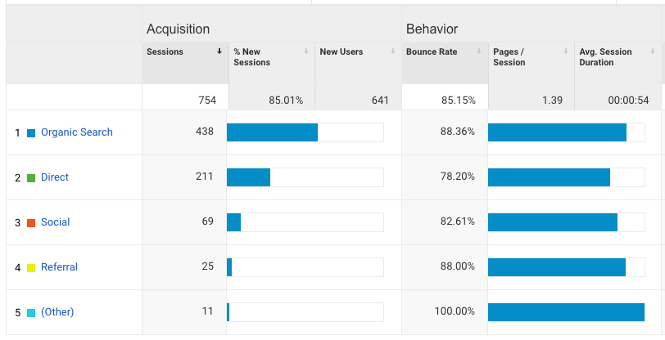
Monitor and Report
Examples of website metric monitoring
Notes:
[REF.] 1.5.3.2

Slide 75
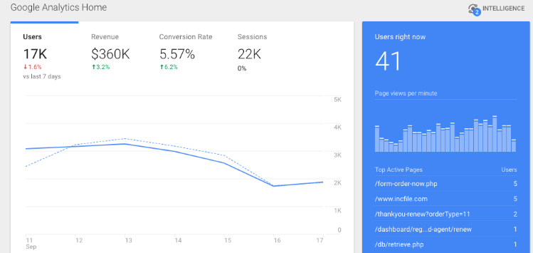
Monitor and Report
Examples of website metric monitoring
Notes:
[REF.] 1.5.3.3

Slide 76
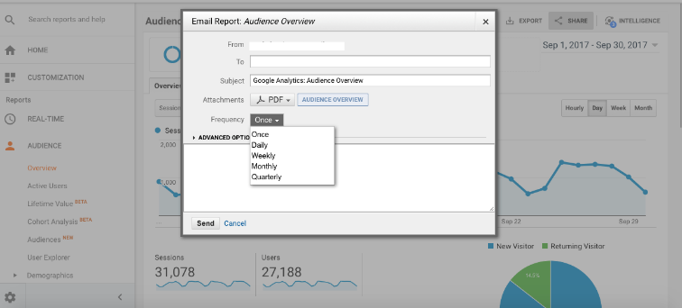
Monitor and Report
Create a schedule of metrics reporting and action implementation
Notes:
[REF.] 1.5.3.4

Slide 77
